Slide 1
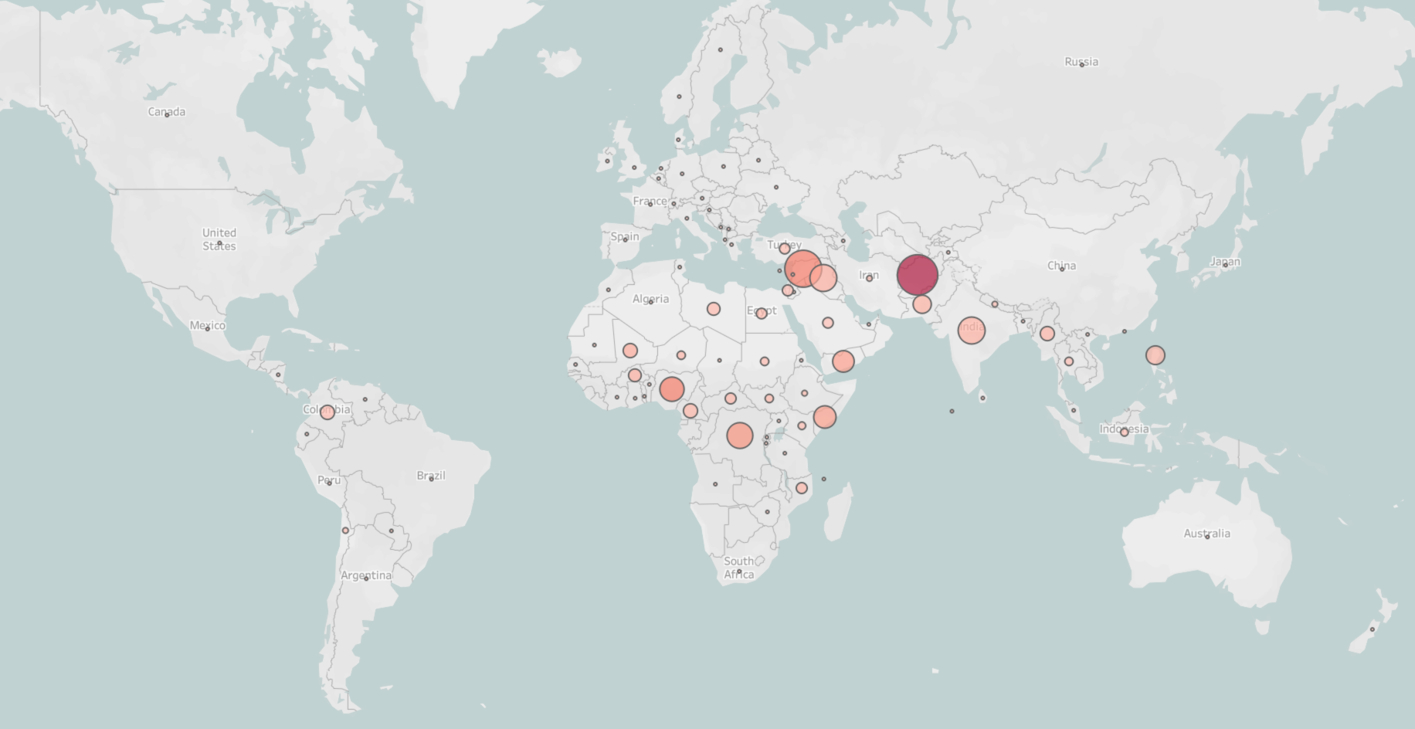
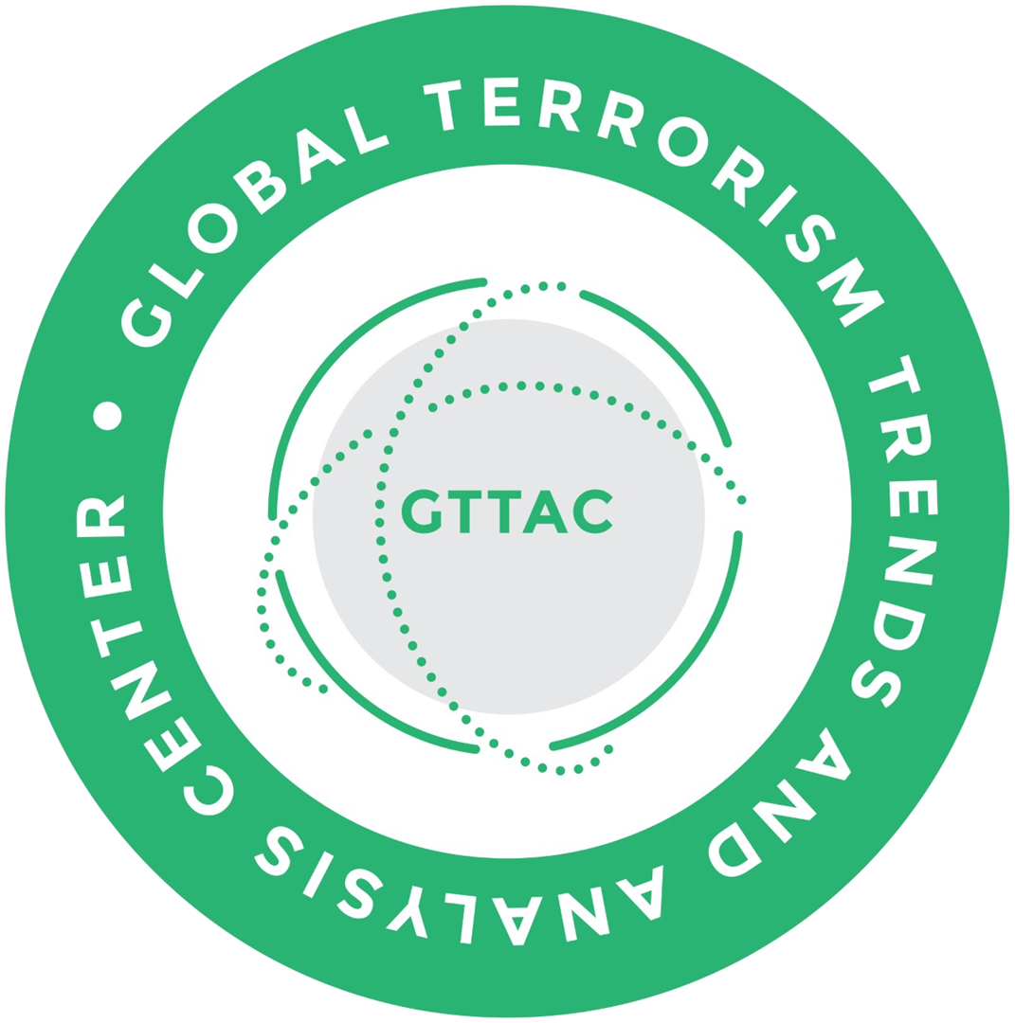

Global Terrorism Trends and Analysis Center
Adam Blackwell
2022 Terrorism Trends
The views, analysis, and information in this presentation are solely from Development Services Group, Inc. (DSG).
Notes:
This presentation is in 4 parts – 1. Intro/Methodology 2. Significant findings 3. Challenges and conclusions 4. Demonstration of the data.

Slide 2

GTTAC Database of Global Terrorism Incidents: GRID www.GTTAC.com
Introduction: Methodology
GRID is a next-generation incident database presenting a summary of global terrorist activity, as reported by open-source intelligence.
Its data are processed by a combination of electronic data acquisition, filtering, human processing, and validation of terrorism incidents.
GRID is live database, updated with the latest validated incidents on a weekly basis, continuous quality control, annual “soft-closeout” every April.
Definition of Terrorism conforms to Title 22, Section 2656f, of the U.S. Code.
A violent act carried out by non-state actors that meets the following inclusion criteria:
The violent act aims to attain a political, economic, religious, or social goal.
The violent act includes evidence of an intention to coerce, intimidate, or convey some other message to an audience (or audiences) larger than the immediate victims.
The violent act occurred outside the precepts of international humanitarian law insofar as it targeted non-combatants.
Notes:
GRID is populated only through open-source media to support the State Department requirements. We follow as closely as possible the legacy definitions and methodologies.

Slide 3
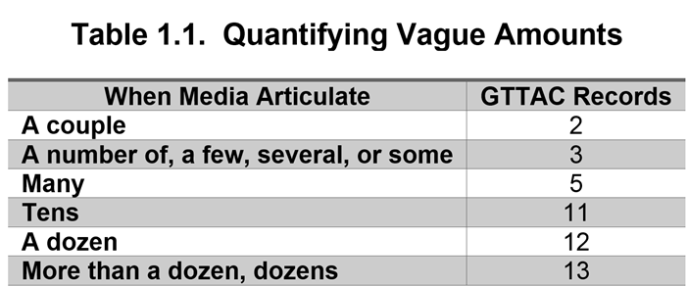
GTTAC Database of Global Terrorism Incidents: GRID www.GTTAC.com
Introduction: Methodology
Now in our fifth year, GTTAC uses multiple, global news aggregators to identify reports of potential terrorist incidents.
We screen millions of news articles using open-source natural language processing tools for inclusion scoring, geoparsing, and deduplication.
These automated processes produce a drastically reduced body of data to be validated by multilingual teams and added to the database of global terrorism incidents: GRID.
GTTAC applies ontologies, terrorist incidents, perpetrators, tactics for attack, weapon use, and the targeting of victims and facilities.
Data elements collected for each incident:
The number of individuals killed
The number of individuals injured
The number of individuals kidnapped
The location (country and state/province) of the incident
The perpetrator responsible for the incident
The attack type (e.g., armed assault, bombing/explosion, hijacking)
The type of target (e.g., business, government, police, military)
Category of perpetrator (jihadist, right wing, etc.)
2
Open-source information can be in precise (e.g., persons killed or injured). GTTAC created the scale at right to aid in the recording of casualties:
Notes:
Requires equal parts good technology, media sources and trained multilingual staff to ensure that the records are complete and accurate. Open-source information is often in precise; dates, casualties and even perpetrators.

Slide 4
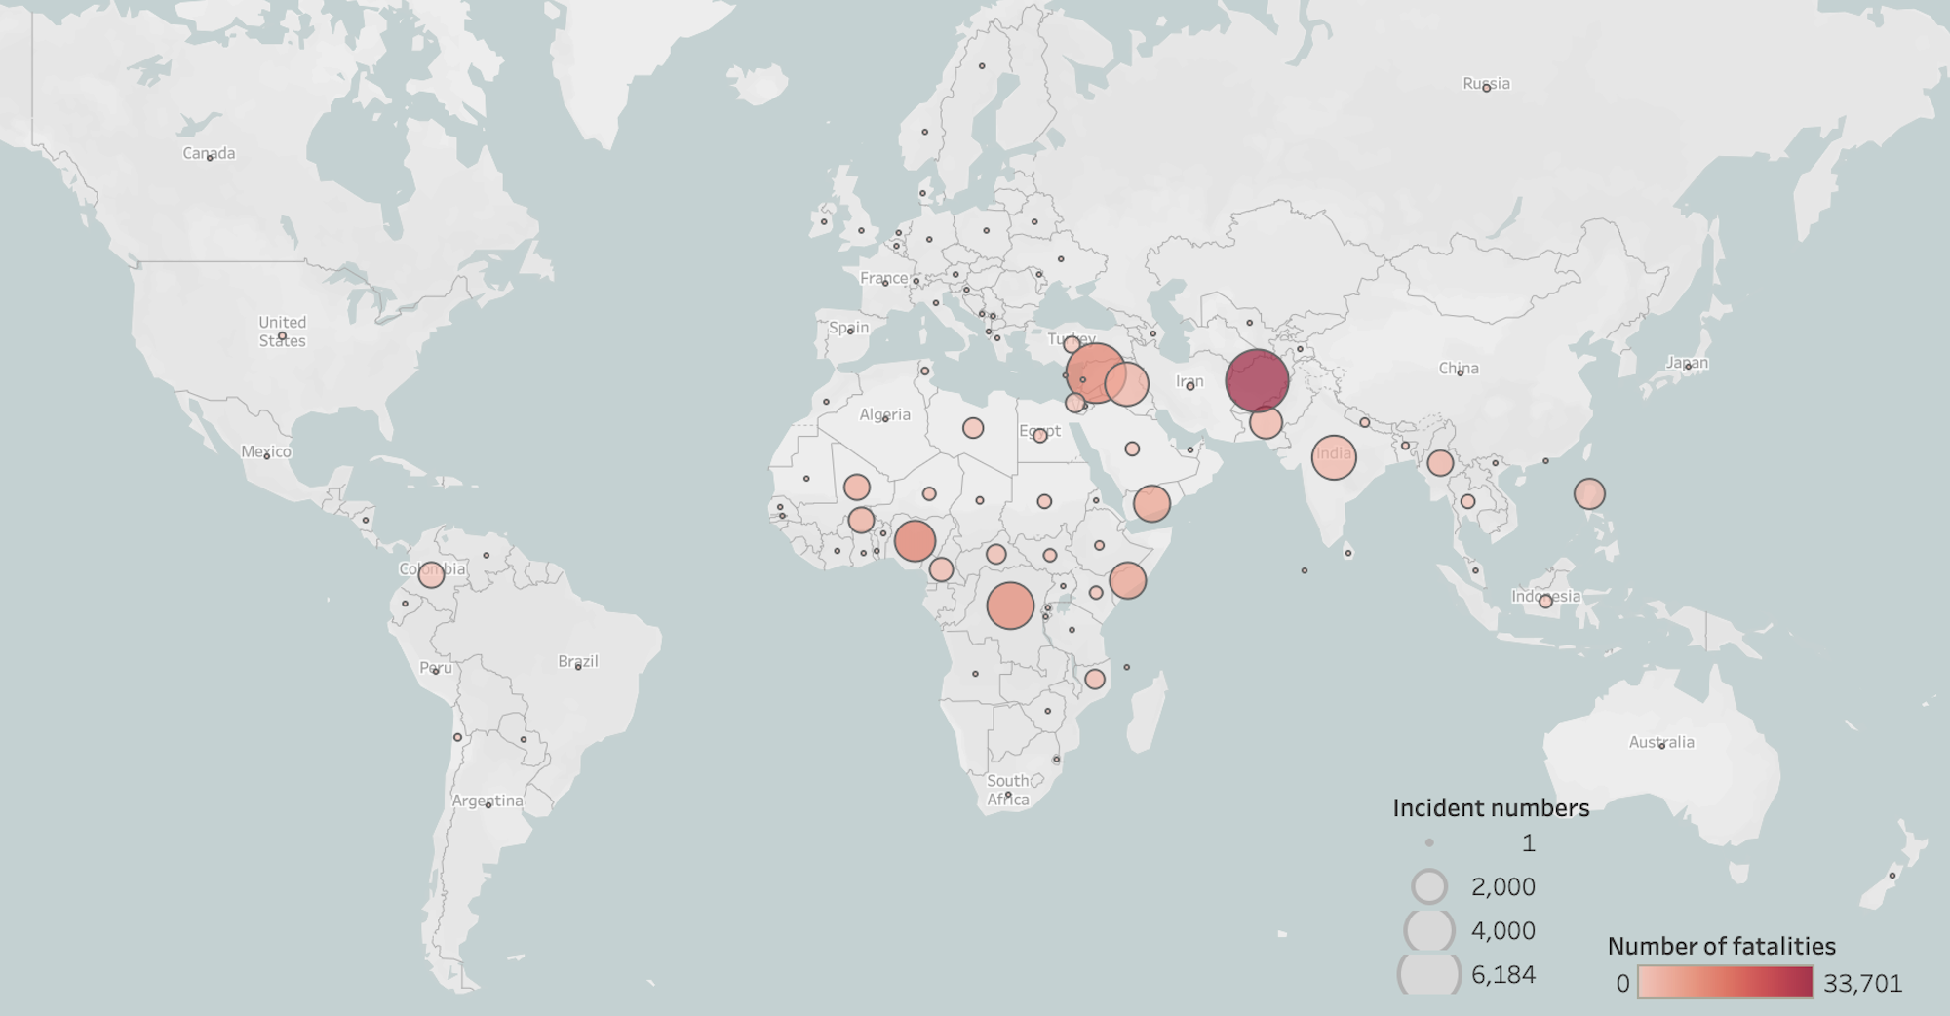
Geographic Distribution of Terrorism Worldwide (2018–2022)
GTTAC Database of Global Terrorism Incidents: GRID www.GTTAC.com
Significant Trends—Global Distribution
Notes:
Geographic Distribution - the size of the circle reflects the number of incidents, and the red color reflects the number of fatalities.

Slide 5
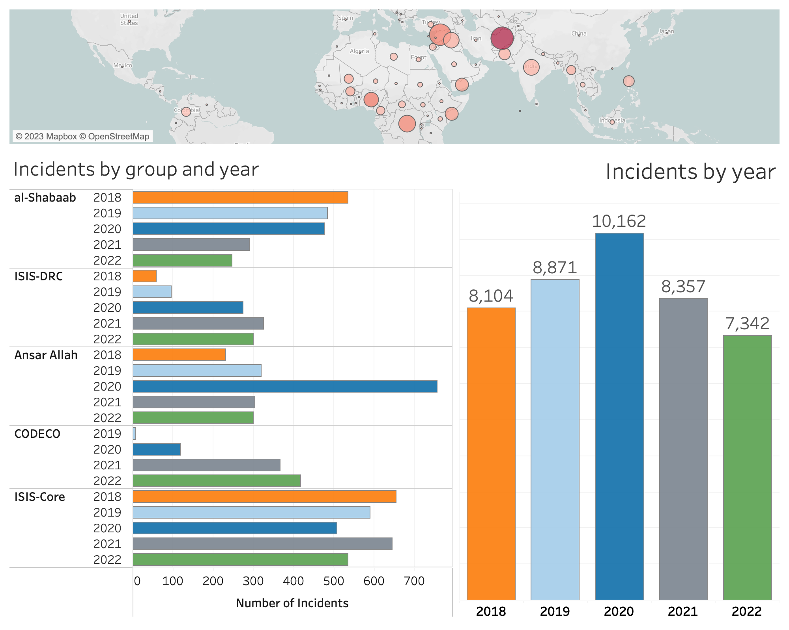
Global incidents and top perpetrators (2018–2022)
GTTAC Database of Global Terrorism Incidents: GRID www.GTTAC.com
Significant Trends—Global Distribution
7,342 terrorist incidents in 2022, down 12% from 2021, with similar reductions in casualties.
In 2022:
~85% of all incidents were concentrated in 3 regions: Western Asia, Southern Asia, and Sub-Saharan Africa.
Terrorist incidents occurred in 72 countries and territories.
In order, the Democratic Republic of the Congo, Syria, Nigeria, Pakistan, India, Iraq, Yemen, Burma, Burkina Faso, and Somalia were the top 10 countries for terrorist incidents in 2022.
Notes:
The reduction is largely due to changes in opensource reporting availability from Afghanistan. Terrorism is sticky, the bulk of the incidents take place in 3 regions. Top 10 countries for 2022 and major perpetrator groups.

Slide 6
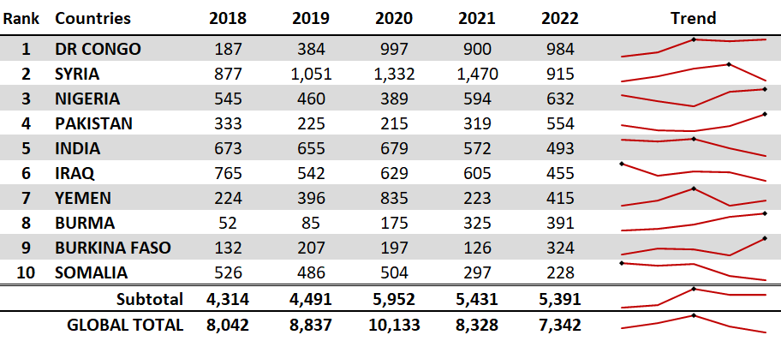
GTTAC Database of Global Terrorism Incidents: GRID www.GTTAC.com
Significant Trends—Country View of Incidents
Notes:
In order, the Democratic Republic of the Congo, Syria, Nigeria, Pakistan, India, Iraq, Yemen, Burma, Burkina Faso, and Somalia were the top 10 countries for terrorist incidents in 2022.
Incidents in these 10 countries accounted for 73% of the overall total number of incidents.

Slide 7
Perpetrators
Perpetrators often are not specifically named by the reporting media, which may identify them as a “jihadist,” “ethnonationalist,” or “right wing.” We have added these descriptors to the data to give readers and analysts a fuller understanding of each incident. The table below reflects the top four perpetrator categories for 2021 and 2022.
Perpetrator Categories
Religious (Jihadist)
Religious (Other-Hindu, Buddhist,
Jewish, Christian)
Iranian Backed
Ethnonationalist/Separatist
Left-Wing/Revolutionary (Marxism-Leninism-Maoism)
Anarchist
Right Wing (Racist/Anti-Government Militia/Anti-Statist/Populist)
Vigilante (Pro-Government)
Single Issue (Abortion, Environment, Animal Rights, Misogynistic)
Unknown.
Notes:
As previously mentioned, credible open-source media often does not identify the perpetrators and based on our methodology we don’t guess, so we created categories or descriptors to add detail to each record.

Slide 8
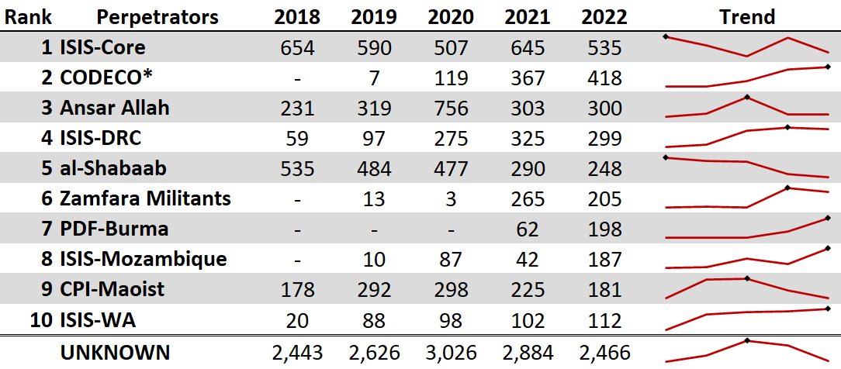
GTTAC Database of Global Terrorism Incidents: GRID www.GTTAC.com
Significant Trends—Perpetrators by Incidents
*CODECO and factions
Notes:
The top 10 perpetrators in 2022 ranked by the number of incidents. These were ISIS-Core (Iraq and Syria), Cooperative for Development of the Congo (CODECO and affiliates), Ansar Allah, ISIS of the Democratic Republic of the Congo (ISIS-DRC), al-Shabaab, Zamfara Militants, the Peoples Defense Force-Burma (PDF), ISIS-Mozambique (ISIS-M), the Communist Party of India-Maoist (CPI-Maoist), and ISIS-West Africa. (ISIS-WA). These top 10 perpetrators accounted for 36 percent of global terrorism activity for 2022

Slide 9
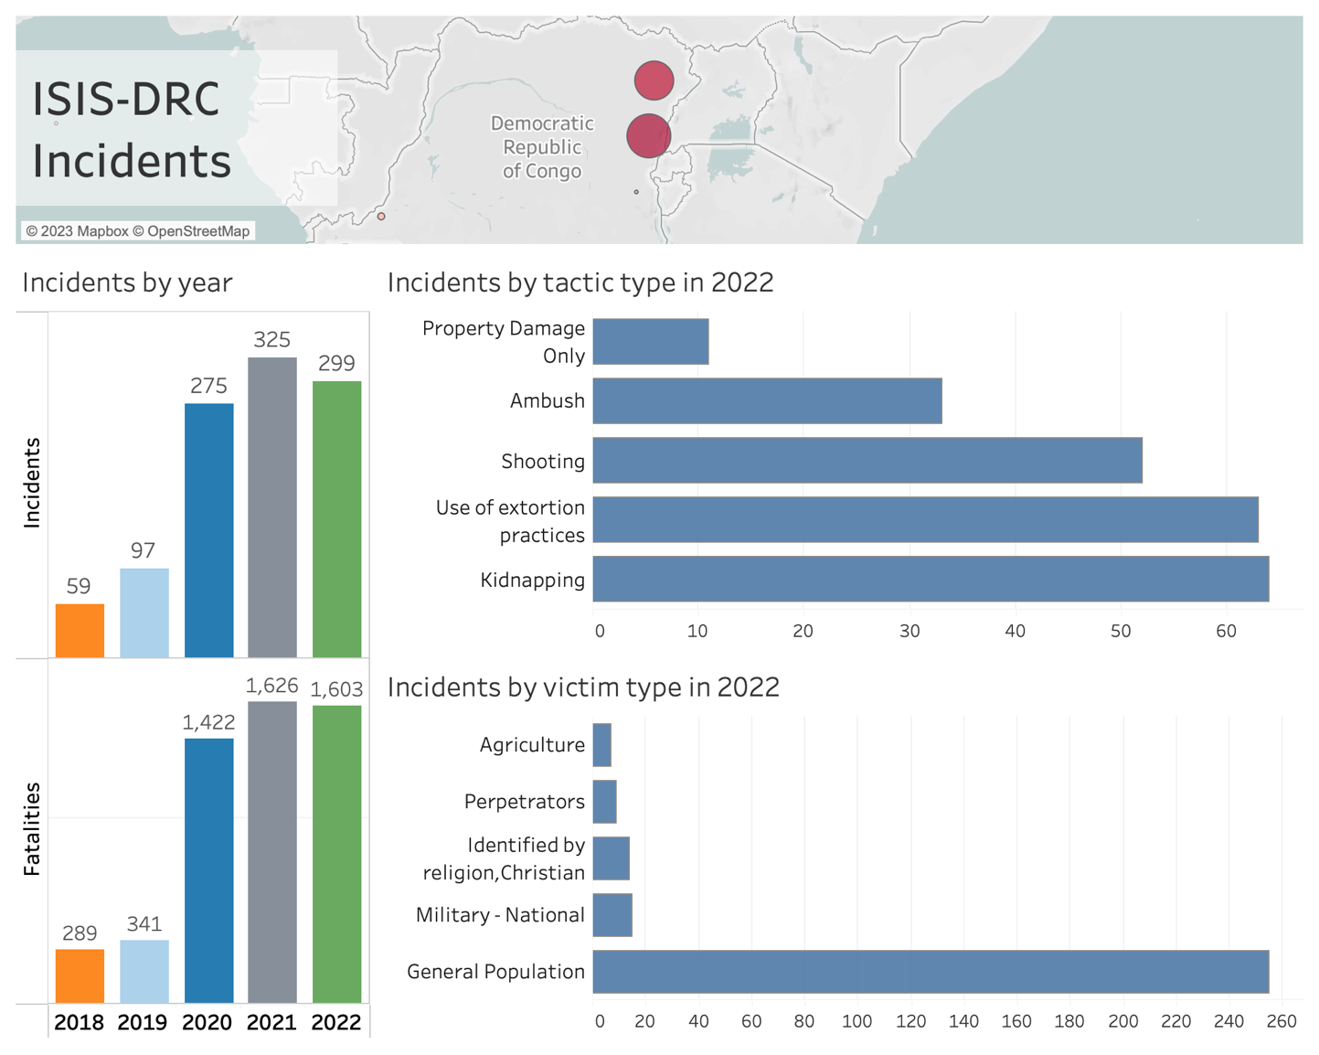
Notes:
ISIS-DRC was designated a foreign terrorist organization by the Department of State in March 2021. Included in the group’s incidents are those attributed to the Allied Democratic Forces (one of ISIS-DRC’s aliases). In 2022 there were 299 incidents involving ISIS-DRC, with 1,603 fatalities and 156 persons wounded. This constitutes a 5 percent reduction in the number of incidents from 2021. The number of fatalities was three fewer than in 2021.
All ISIS-DRC’s incidents in 2022 were concentrated in the Democratic Republic of the Congo (293 incidents) or Uganda (6 incidents).
Common tactics ISIS-DRC employed in incidents included extortion (21 percent), kidnappings (22 percent), and executions (5 percent).
In 2022 the victims in 85 percent of ISIS-DRC-incidents were the general population. Other prominent victims of ISIS-DRC violence included military (5 percent of incidents) and Christians (5 percent of incidents).
Most ISIS-DRC incidents were concentrated in either the Nord/North-Kivu province of the Democratic Republic of the Congo with 164 incidents (55 percent) or Ituri with 129 incidents (43 percent).

Slide 10
GTTAC Database of Global Terrorism Incidents: GRID www.GTTAC.com
Conclusions
There are challenges:
Definitional issues: terrorism, conflict, state versus non-state actors.
Terrorism perpetrators lack homogeneity and are highly adaptive.
Paucity of reliable, credible, open-source media.
Need to be opportunistic:
Use of technology, using multilingual/multicultural teams and open-source data, to create integrated approaches for terrorism analysis.
Collaboration and coordination across jurisdictions and agencies.
Analysis can help inform government agencies in their response.
Notes:
In conflict zones, it is often difficult to ascertain who is involved in a potential terrorist incident.
There frequently are multiple non-state actors who serve as unofficial and unrecognized proxies for state actors.
In situations where there is little to no government presence, reporting on terrorist incidents can be inaccurate, biased, or misleading.

Slide 11
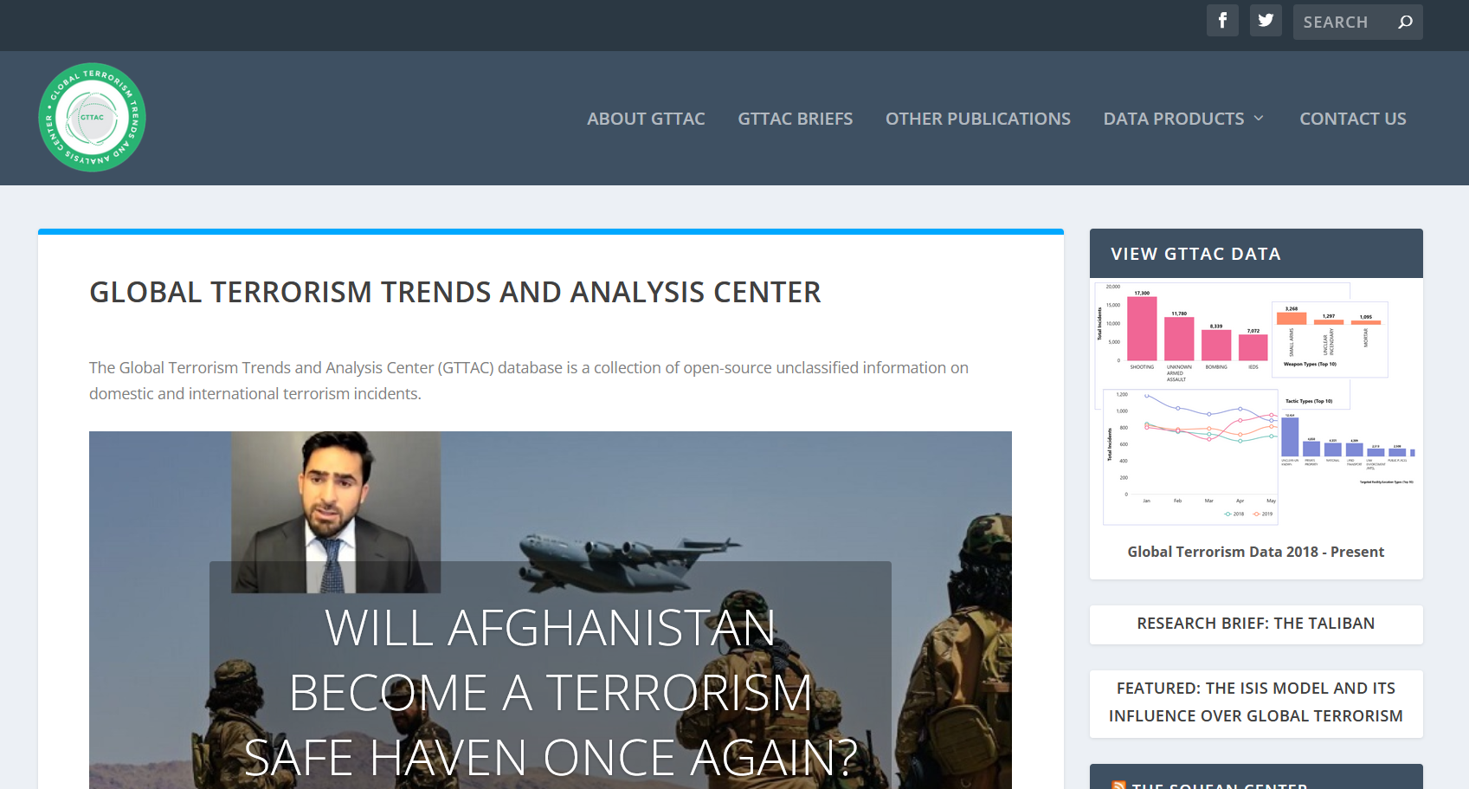

Slide 12
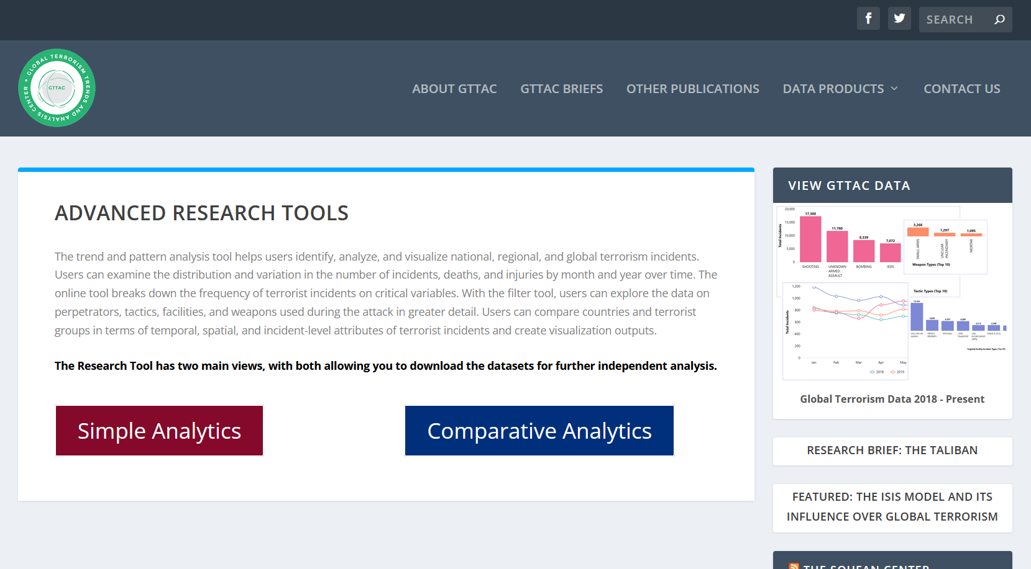

Slide 13
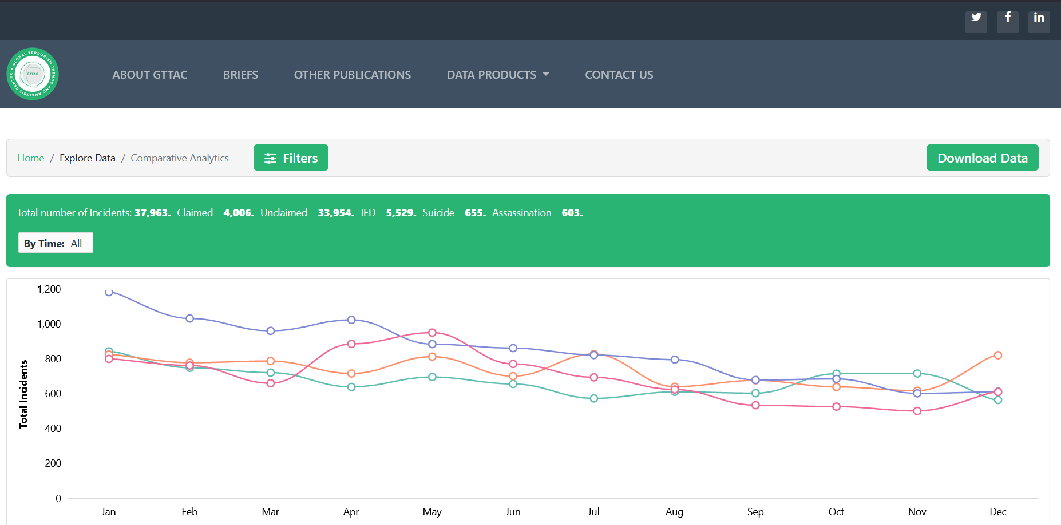
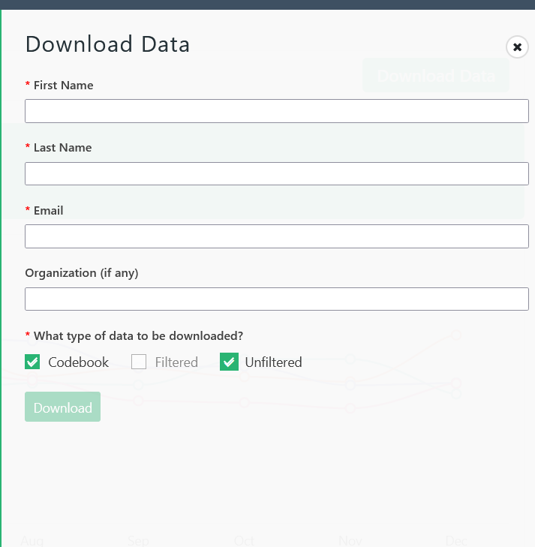

Slide 14
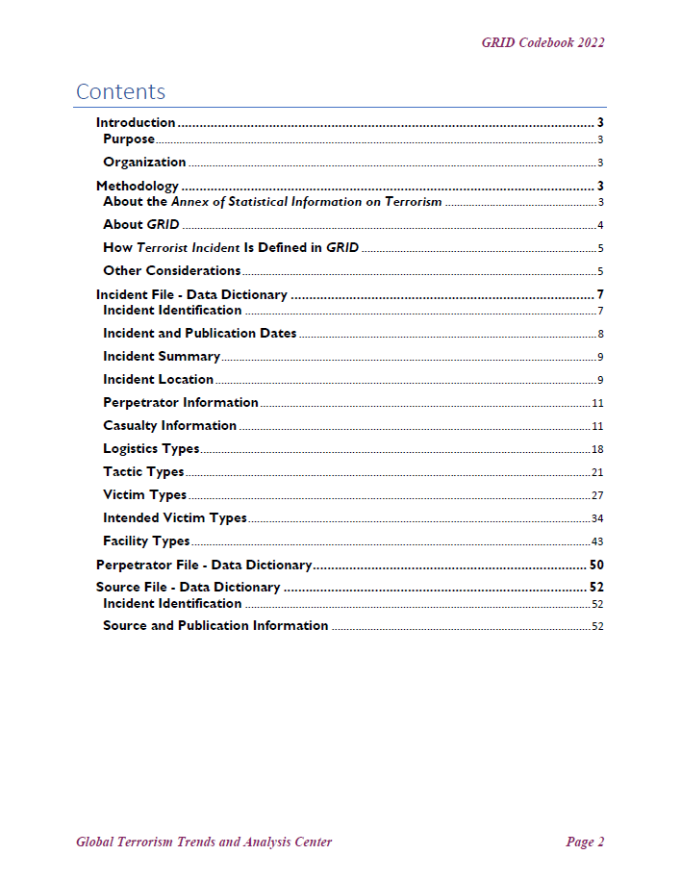
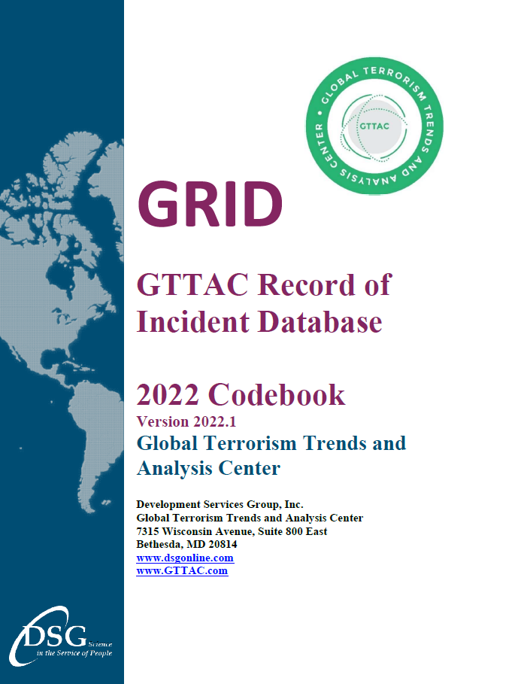
Codebook
Zip file
Updated periodically
Describes all data elements
  in the GRID files.

Slide 15
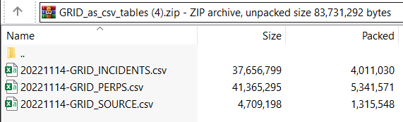
GRID Data Files
Three CSV files in the zip download:
  Incident File
  Perp File
  Source File
Data are updated every week with most recently validated files.

Slide 16
Thank You!
GetHelp@gttac.com
Adam Blackwell, ablackwell@dsgonline.com

